Slide 1


Slide 2
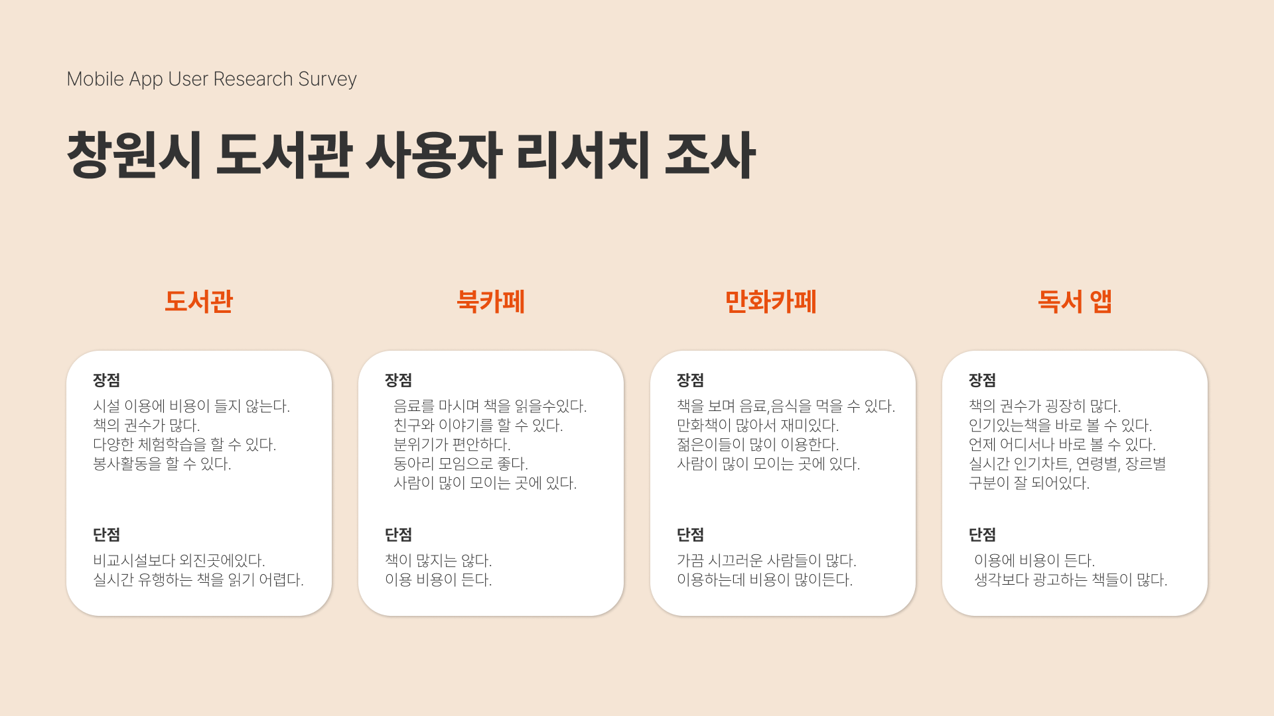

Slide 3
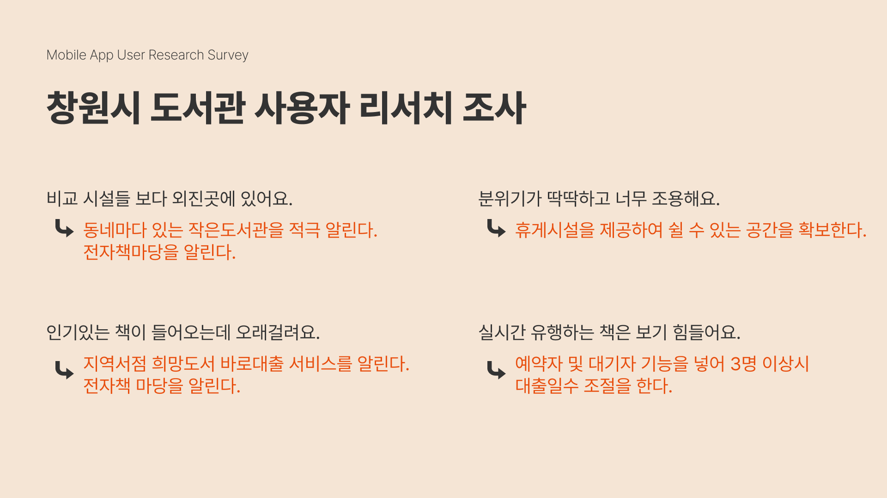

Slide 4
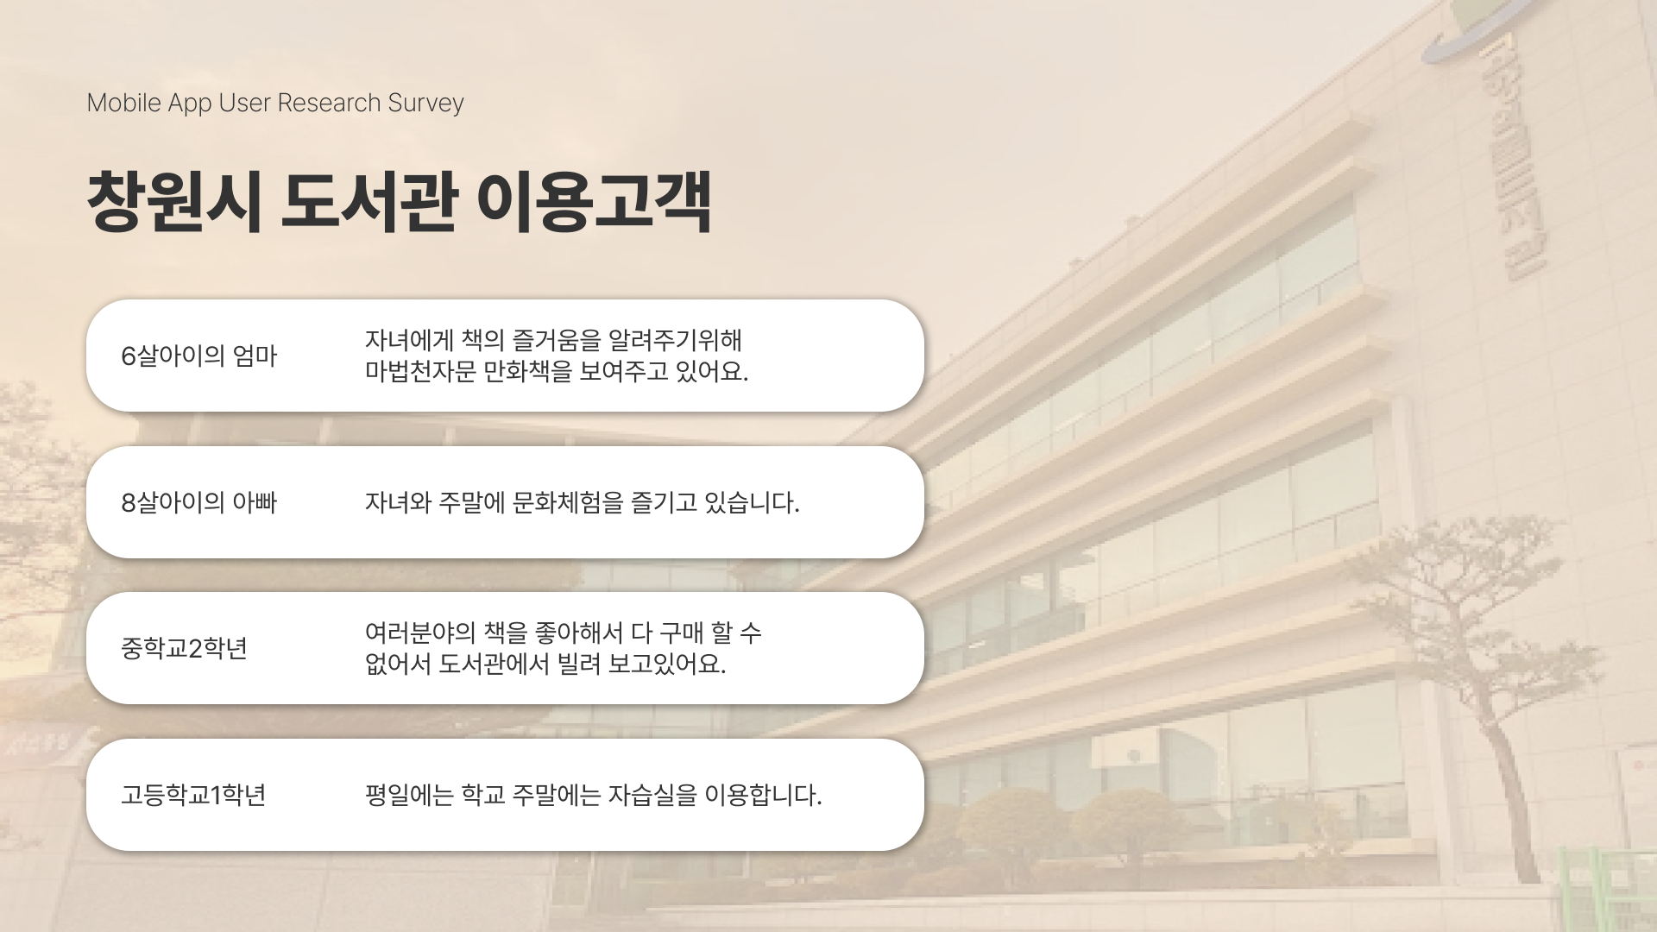

Slide 5
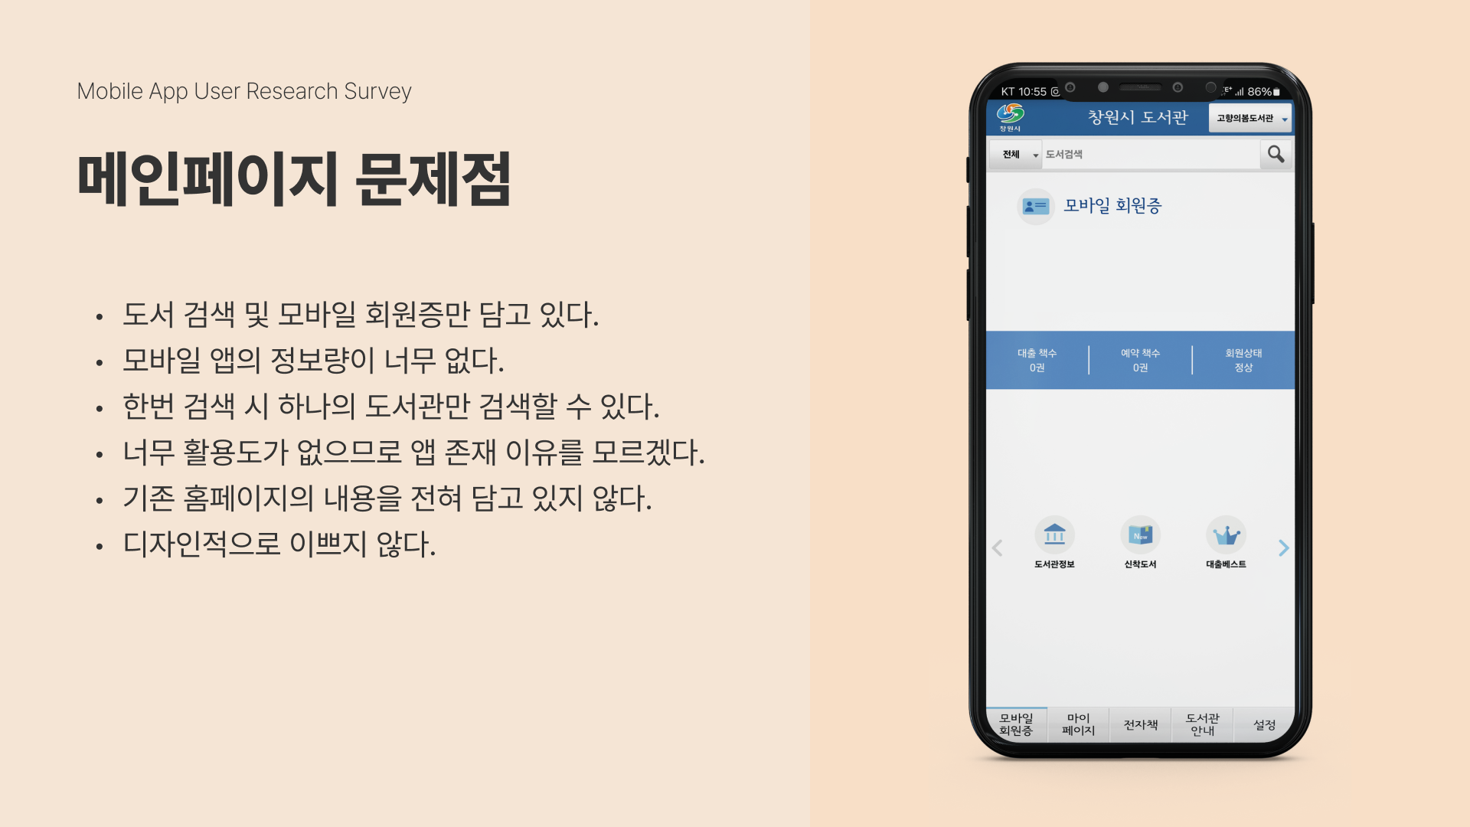

Slide 6
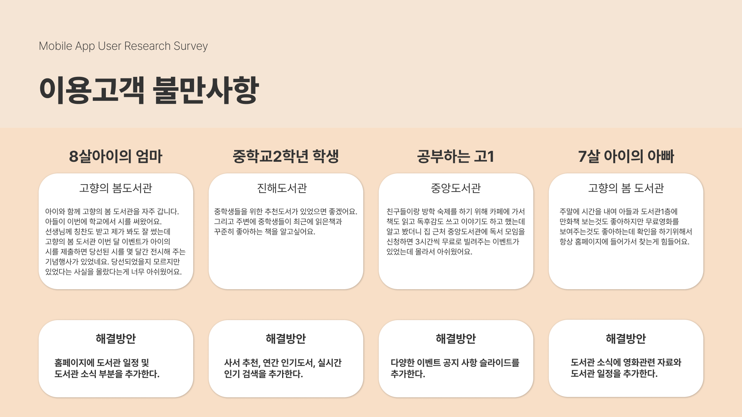

Slide 7


Slide 8


Slide 9



Slide 10


Slide 11
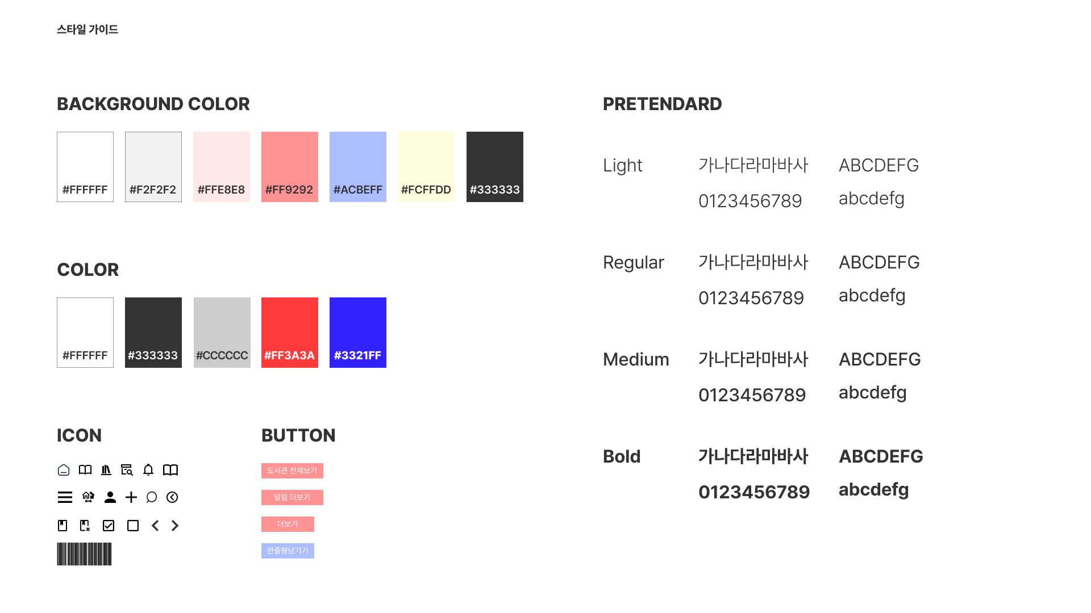

Slide 12
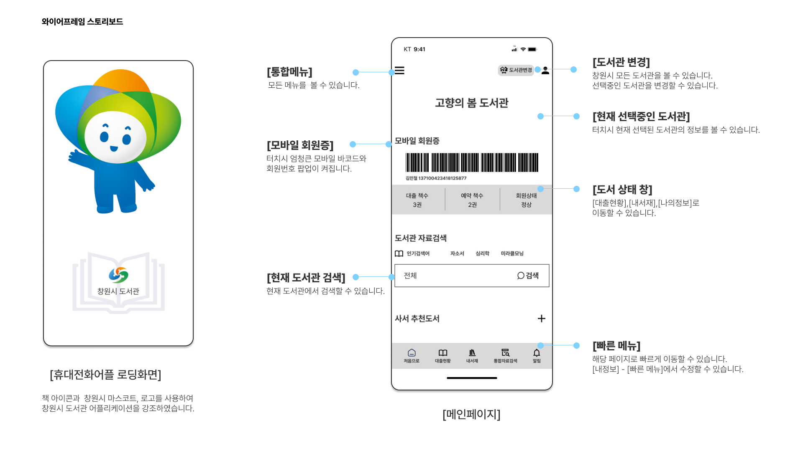

Slide 13
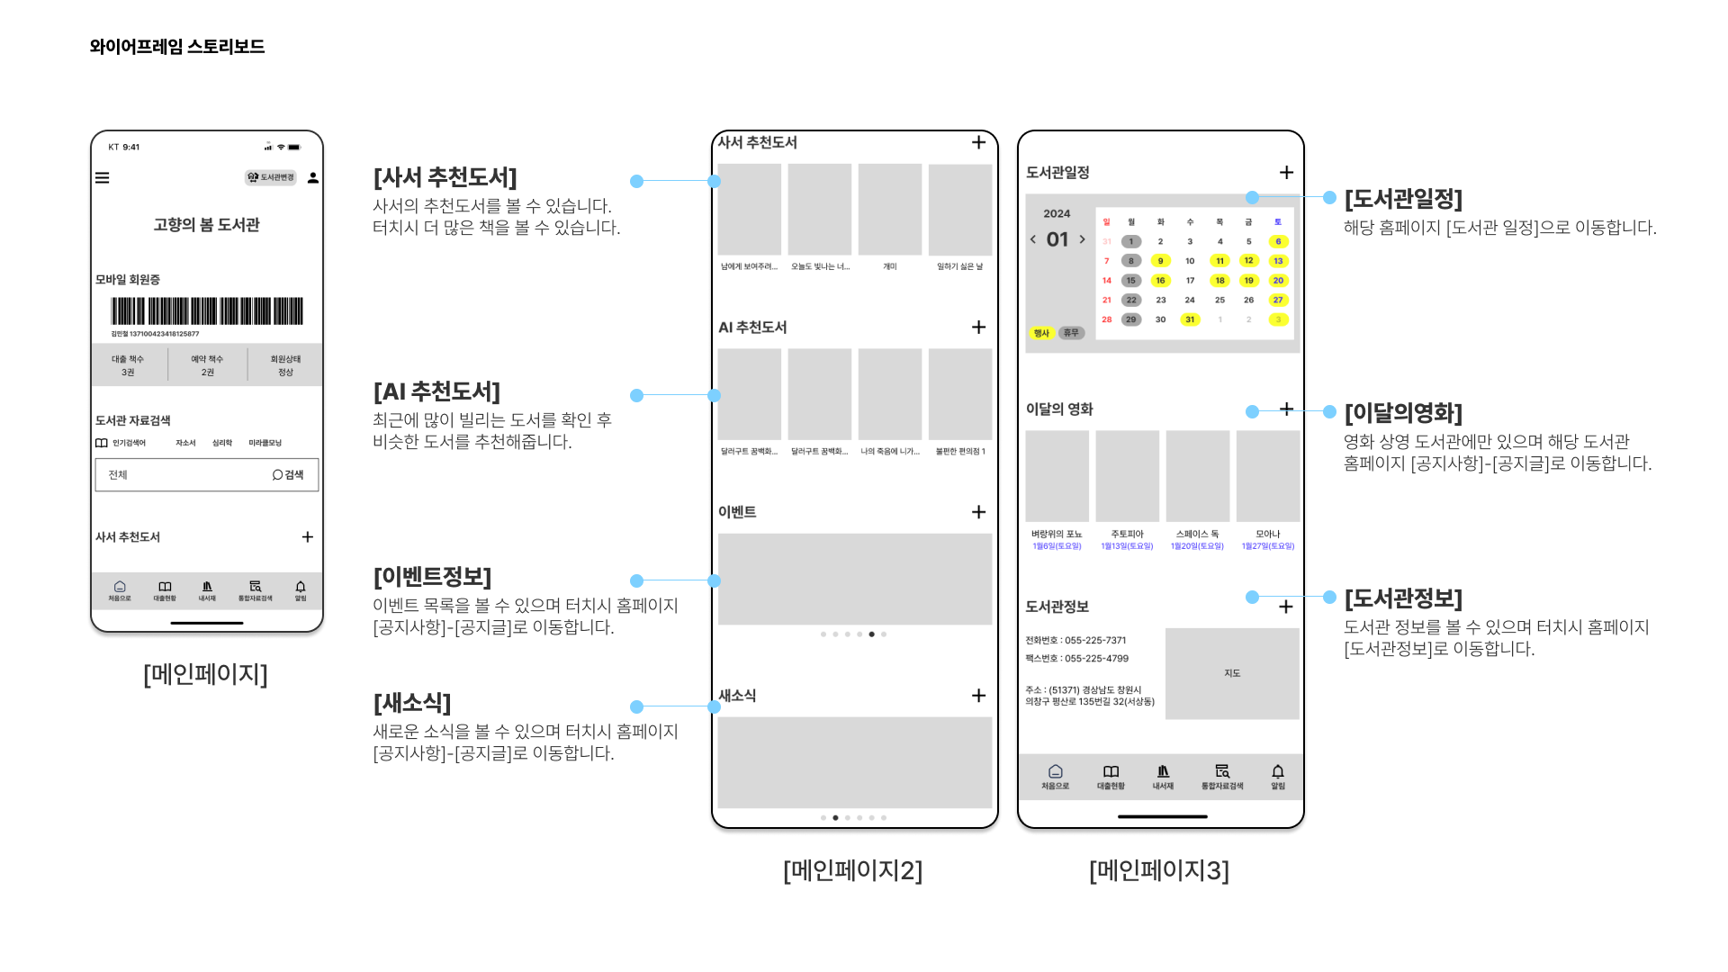

Slide 14
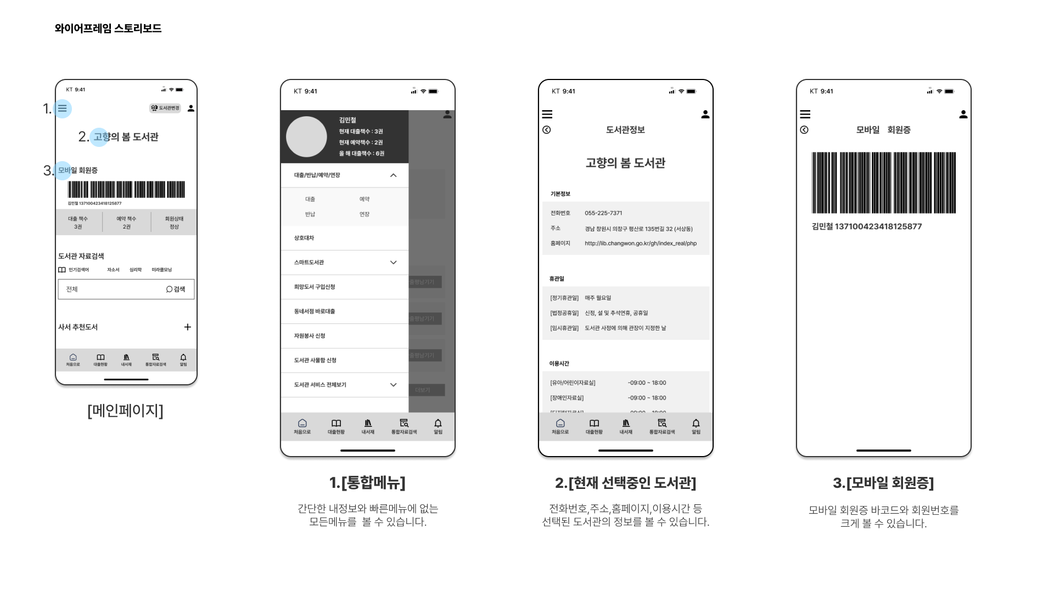

Slide 15
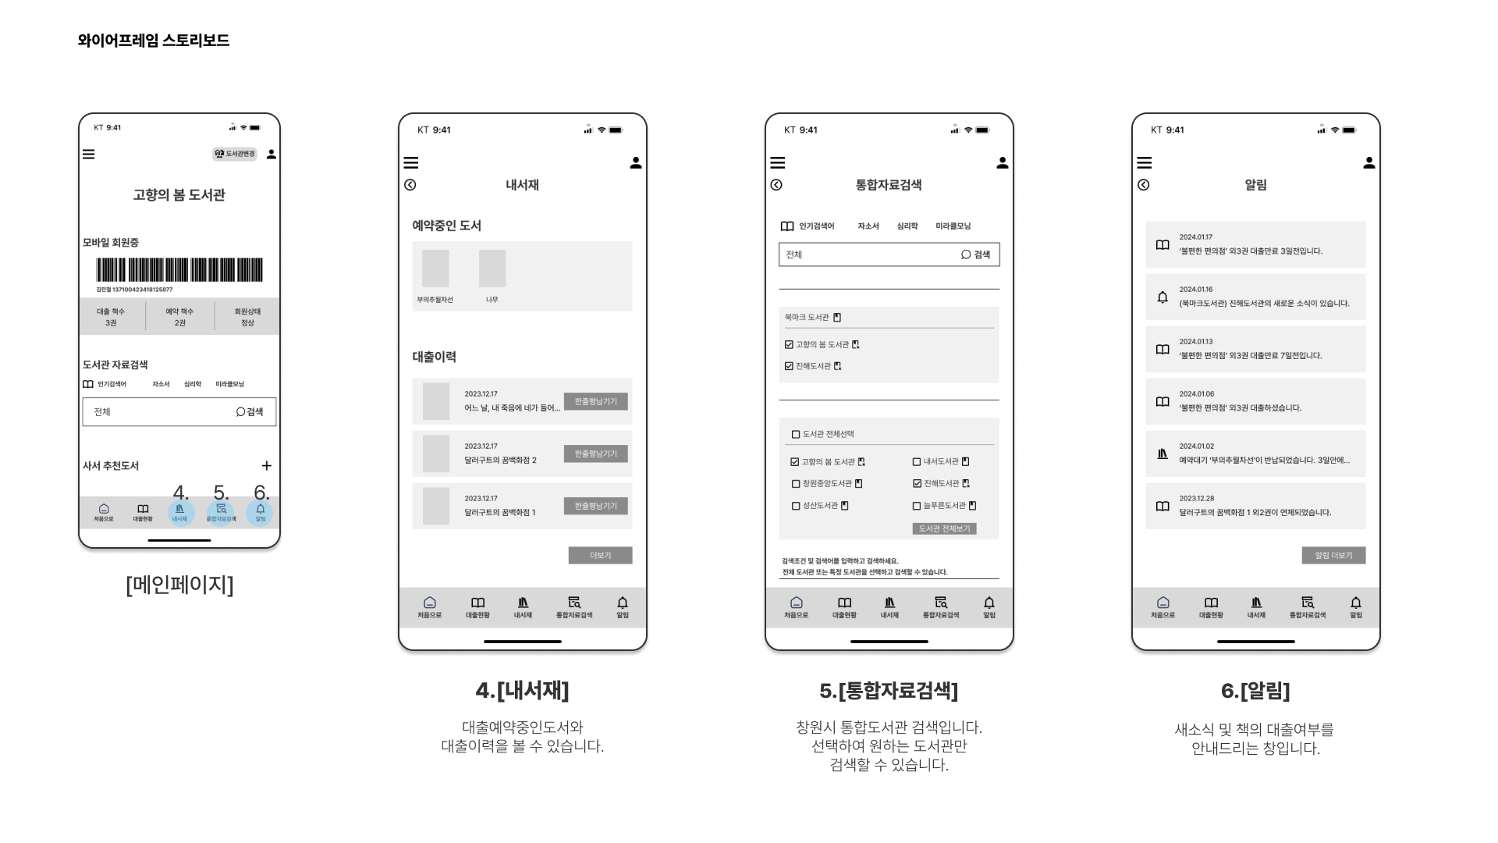

Slide 16
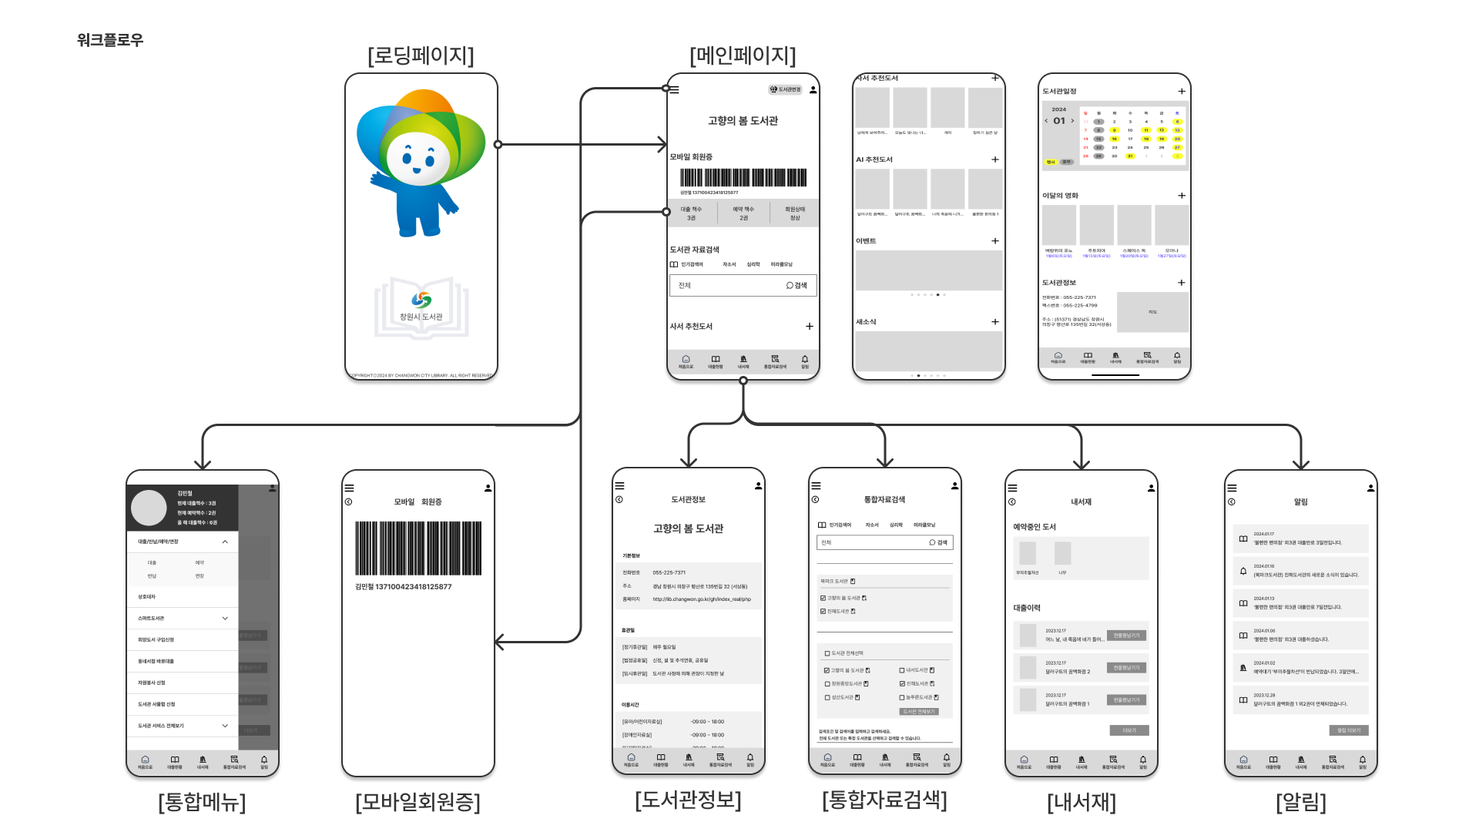

Slide 17
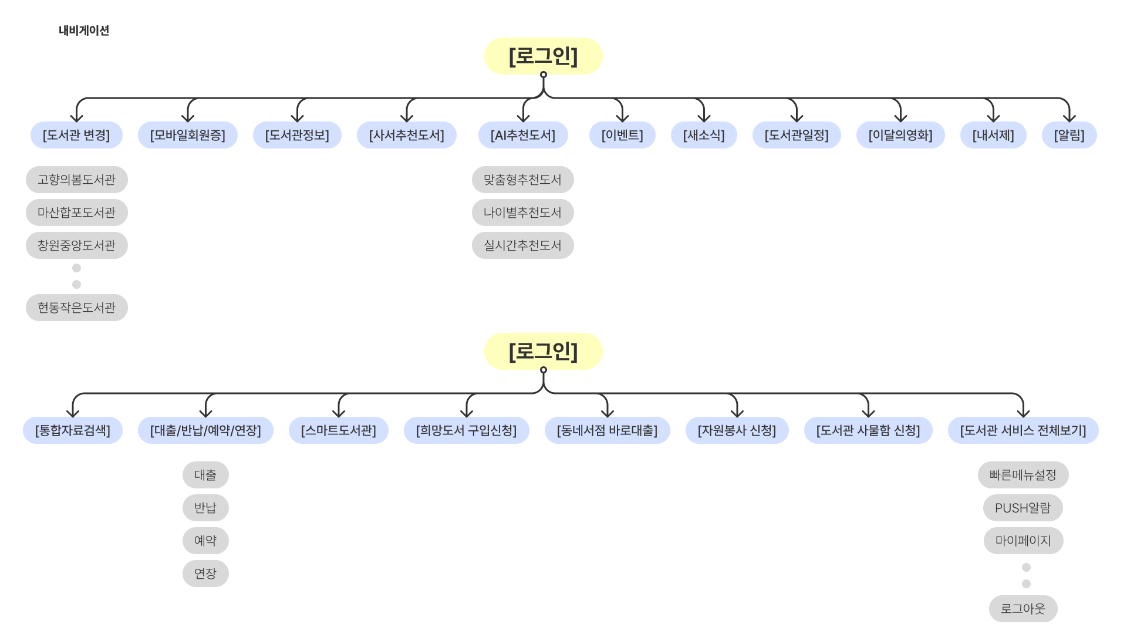

Slide 18



와이어프레임 디자인
https://www.figma.com/file/6S8STOYfUZelglZ7ONiOfj/changwonApp?type=design&node-id=1-6&mode=design&t=HbBeNJz5InHSykEO-0
디자인시안
https://www.figma.com/file/6S8STOYfUZelglZ7ONiOfj/changwonApp?type=design&node-id=2021-685&mode=design&t=HbBeNJz5InHSykEO-0

